Slide 1
LDA & Word2Vec
Yizhu
2017.4.30
Notes:
Today I will give a talk about LDA and Word2Vec
When we do some work about NLP. We will face some problems.
How we represent words as input for all the NLP tasks.
How we represent meaning of words.
Both LDA and Word2Vec can make the word representation come true.

Slide 2
Contents
— Review：Word2Vec
— LDA (Latent Dirichlet Allocation)
— Difference
— LDA2Vec
Notes:
In the next time, I will introduce the LDA and word2vec according to these 4 aspects.
First, I will give a review of word2vec. Because the word2vec has been introduced in previous seminar.
Next, I will explain LDA(Latent Dirichlet Allocation) model in detial.
Then we can compare LDA and Word2Vec. I think we can find something new in this process.
Finally, I want to give you a brief intro about a new method of word representation. It is a combination of LDA and word2vec. It’s named LDA2Vec.

Slide 3
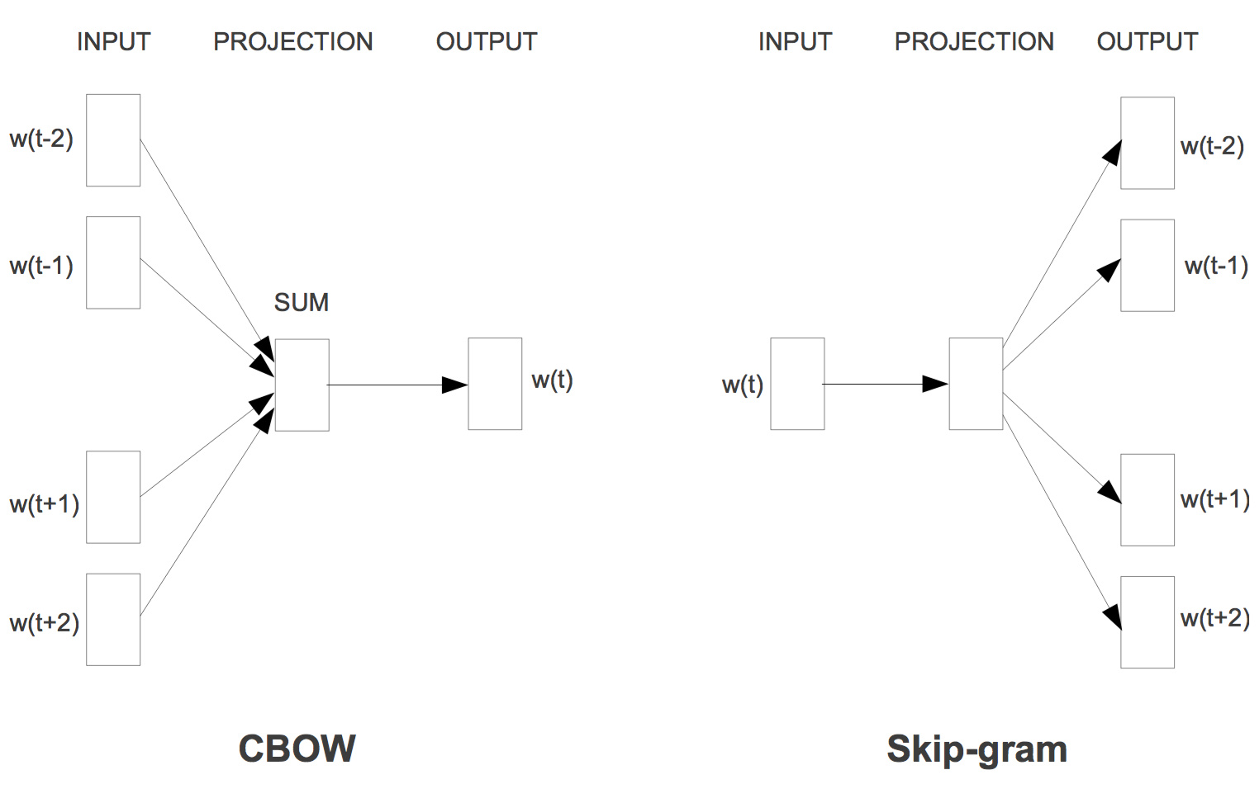
Review：Word2Vec
Notes:
Word2vec is a group of related models that are used to produce word embeddings.
These models are two-layer neural networks that are trained to reconstruct linguistic contexts of words.
Word2vec takes as its input a large corpus of text and produces a vector space.
Each unique word in the corpus being assigned a corresponding vector in the space.
The words that share common contexts in the corpus are located in close proximity to one another in the space
There are two models in Word2Vec.
The CBOW architecture predicts the current word based on the context.
And the Skip-gram predicts surrounding words given the current word.

Slide 4
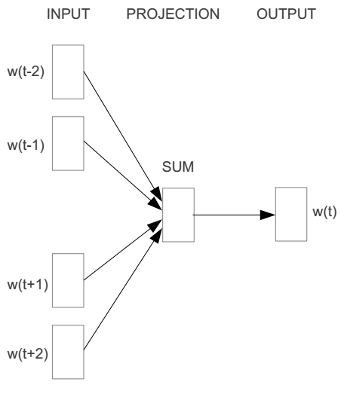
Word2vec – Continuous Bag of Word
E.g. “The cat sat on floor”
Window size = 2
the
cat
sat
on
floor
Notes:
In this part, I will use the CBOW model as an example. The Skip-Gram is like a mirror of CBOW.
The idea of CBOW model is to learn word vector wt from its surrounding context
For example, the sentence ‘…….’.
We want get the word vector of word set

Slide 5
Input layer
Index of cat in vocabulary
0
1
0
cat
0
Hidden layer
Output layer
0
0
0
0
0
0
…
0
0
0
one-hot
vector
0
sat
one-hot
vector
0
0
0
0
1
0
…
1
0
on
0
0
0
0
…
0
Notes:
the input vector is a hot-vector
The index of elements 1 in the input vector corresponds to the index of the word in vocabulary

Slide 6



We must learn W and W’
Input layer
0
1
0
cat
0
$$W_{V×N}$$
Hidden layer
Output layer
0
0
0
0
0
0
V-dim
…
0
0
$${W′}_{N×V}$$
0
0
sat
0
0
0
0
1
0
$$W_{V×N}$$
N-dim
…
V-dim
1
0
on
0
0
0
0
V-dim
…
N will be the size of word vector
0
Notes:
To make true that the true vector of word sat and its predicted vector are as similar as possible

Slide 7

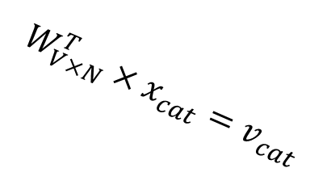



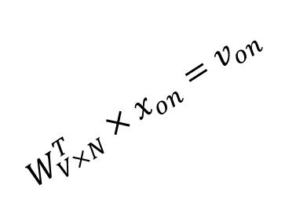
$$W_{V×N}^{T} ×x_{cat}=v_{cat}$$
0.1 | 2.4 | 1.6 | 1.8 | 0.5 | 0.9 | … | … | … | 3.2
0.5 | 2.6 | 1.4 | 2.9 | 1.5 | 3.6 | … | … | … | 6.1
… | … | … | … | … | … | … | … | … | …
… | … | … | … | … | … | … | … | … | …
0.6 | 1.8 | 2.7 | 1.9 | 2.4 | 2.0 | … | … | … | 1.2
0
2.4
2.6
…
…
1.8
Input layer
1
$$×$$
0
$$=$$
0
0
1
0
0
0
x_{cat}
0
0
Output layer
0
0
0
$$W_{V×N}^{T}×x_{cat}=v_{cat}$$
…
0
0
0
0
0
V-dim
…
0
0
$$\hat{v}=\frac{v_{cat}+v_{on}}{2}$$
0
+
0
sat
0
0
0
0
$$W_{V×N}^{T}×x_{on}=v_{on}$$
1
0
…
V-dim
1
Hidden layer
0
x_{on}
0
0
N-dim
0
0
V-dim
…
0
Notes:
The matrix W is randomly generated.
Use W times input vector We can get the vector cat and vector on.

Slide 8

$$W_{V×N}^{T} ×x_{on}=v_{on}$$
0.1 | 2.4 | 1.6 | 1.8 | 0.5 | 0.9 | … | … | … | 3.2
0.5 | 2.6 | 1.4 | 2.9 | 1.5 | 3.6 | … | … | … | 6.1
… | … | … | … | … | … | … | … | … | …
… | … | … | … | … | … | … | … | … | …
0.6 | 1.8 | 2.7 | 1.9 | 2.4 | 2.0 | … | … | … | 1.2
0
1.8
2.9
…
…
1.9
Input layer
0
$$×$$
0
$$=$$
0
1
1
0
0
0
x_{cat}
0
0
Output layer
0
0
0
$$W_{V×N}^{T}×x_{cat}=v_{cat}$$
…
0
0
0
0
0
V-dim
…
0
0
$$\hat{v}=\frac{v_{cat}+v_{on}}{2}$$
0
+
0
sat
0
0
0
0
$$W_{V×N}^{T}×x_{on}=v_{on}$$
1
0
…
V-dim
1
Hidden layer
0
x_{on}
0
0
N-dim
0
0
V-dim
…
0
Notes:
Then, calculate the average of these two word vectors in the hidden layer.

Slide 9



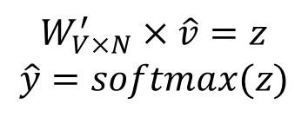

Input layer
0
We would prefer $\hat{y}$ close to ${\hat{y}}_{sat}$
1
0
cat
0
$$W_{V×N}$$
Hidden layer
Output layer
0
0
0
0
0.01
0.02
0.00
0.02
0.01
0.02
0.01
0.7
…
0.00
0
0
V-dim
…
0
0
$$W_{V×N}^{′}×\hat{v}=z$$
$$\hat{y}=softmax(z)$$
0
0
0
0
0
0
$$\hat{v}$$
1
0
$$W_{V×N}$$
…
1
N-dim
0
on
0
${\hat{y}}_{sat}$
0
0
V-dim
0
V-dim
…
N will be the size of word vector
$\hat{y}$
0
Notes:
We use the multiplication of W and v as the output vector.
Transform the output vector by softmax function.
The softmax makes the range of the vector elements from 0 to1.
Then, use gradient descent on the softmax prob to update the weight matrix.

Slide 10




We can consider either W or W’ as the word’s representation. Or even take the average.
$$W_{V×N}^{T}$$
0.1 | 2.4 | 1.6 | 1.8 | 0.5 | 0.9 | … | … | … | 3.2
0.5 | 2.6 | 1.4 | 2.9 | 1.5 | 3.6 | … | … | … | 6.1
… | … | … | … | … | … | … | … | … | …
… | … | … | … | … | … | … | … | … | …
0.6 | 1.8 | 2.7 | 1.9 | 2.4 | 2.0 | … | … | … | 1.2
Contain word’s vectors
Input layer
0
1
0
x_{cat}
0
Output layer
0
0
$$W_{V×N}^{}$$
0
0
0
0
V-dim
…
0
0
$$W_{V×N}^{′}$$
0
0
sat
0
0
0
0
1
0
$$W_{V×N}^{}$$
…
1
0
V-dim
x_{on}
0
Hidden layer
0
N-dim
0
0
V-dim
…
0
In a conclusion, word2vec can map word in the vocabulary to the K dimensional vector space.
Notes:
W contains input word vectors.
W’ contains output word vectors.
We can consider either W or W’ as the word’s representation. Or even take the average.
In a conclusion, word2vec can map word in the vocabulary to the K dimensional vector space.

Slide 11
LDA
What is Latent Dirichlet Allocation (LDA)?
A generative probabilistic model for collections of discrete data such as text corpora.
LDA is a three-level hierarchical Bayesian model, in which each item of a collection is modeled as a finite mixture over an underlying set of latent topics.
What is it used for?
The fitted model can be used to estimate the similarity between documents as well as between a set of specified keywords using an additional layer of latent variables which are referred to as topics.
Notes:
In turn, each topic is modeled as an infinite mixture over an underlying set of topic probabilities.
Each observed word originates from a topic that we do not directly observe.

Slide 12
LDA
Notation and terminology
1. A word is the basic unit of discrete data ,from vocabulary indexed by {1,…,V}.
The vth word is represented by a V-vector w such that w^{v} = 1 and w^{u} = 0 for u≠v.
2. A document is a sequence of N words denoted by w = (w₁,w₂,…,w_{N}).
3. A corpus is a collection of M documents denoted by D = {w₁,w₂,…,w_{M}}.
Notes:
Before introduce the LDA model, let’s define the following terms

Slide 13
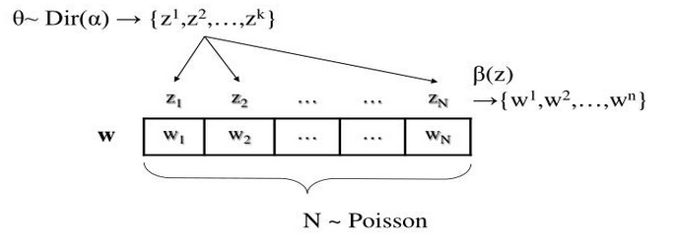
LDA
Generative process for each document w in a corpus D:
1. Choose N ~ Poisson(ξ)
2. Choose θ ~ Dir(α)
3. For each of the N words w_{n}
Choose a topic z_{n} ~ Multinomial(θ)
Choose a word w_{n} from p(w_{n}|z_{n}, β), a multinomial probability conditioned on the topic z_{n}
β is a k×V matrix, β_{ij} = p(w^{j} = 1| z^{i} = 1)
Notes:
This is the representation of a document generation.
We get the number of words in document W from Poisson. There are N words in the document W.
We get the topic distribution θ from the Dir(α). α is in the corpus level. It is the parameters of Dir()

Slide 14
LDA
Several simplifying assumptions:
The dimensionality k of Dirichlet distribution is known and fixed
2. The word probabilities β is fixed quantity that is to be estimated
3. Document length N is independent of all the other data generating variable θ and z
Notes:
We give several simplifying assumptions for this model

Slide 15

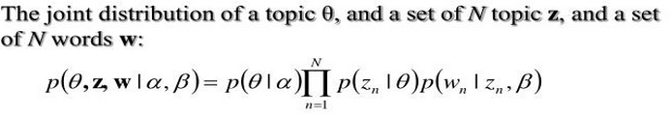
LDA
A k-dimensional Dirichlet random variable θ can take values
in the (k-1)-simplex :
θ ~ Dir(α)
Notes:
a is a k-vector, Gamma function
Θ is a topic vector, each column shows the probability of the topic in the document.
P (Θ|a) is specific for the distribution, Dirichlet distribution
We can use a picture to explain this function.

Slide 16
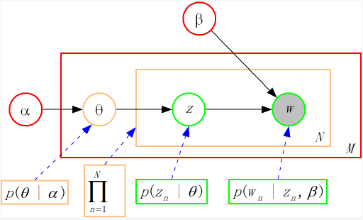

LDA
There are three levels to LDA representation
αβ ar
EM Algorithm:
E-step: αβ as input M-step: maximize the likelihood function
likelihood function αβ as output
Notes:
First select a topic vector theta and determine the probability of each selected topic. Then, in the generation of each word, select a topic z from the topic distribution vector theta. Last, generate a word by the probability distribution of the word distribution in topic z
首先选定一个主题向量θ，确定每个主题被选择的概率。然后在生成每个单词的时候，从主题分布向量θ中选择一个主题z，按主题z的单词概率分布生成一个单词
通过上面对LDA生成模型的讨论，可以知道LDA模型主要是从给定的输入语料中学习训练两个控制参数α和β，可以用来生成文档。
Take w as observation variables, Θ and z as hidden variables, you can learn alpha and beta through the EM algorithm.
每次E-step输入α和β，计算似然函数，M-step最大化这个似然函数，算出α和β，不断迭代直到收敛。
iterate α and β until convergence
N is the number of words in the generative documents
Wn is the nth word Zn is the selected topic
P (z| Θ) indicates the probability distribution of the topic z given Θ. The value is Θ. P (z=i| theta) = theta _i
p(w|z) is the distribution of word when the topic z is given.

Slide 17
Quiz
Can you find some differences between LDA and Word2Vec?

Slide 18
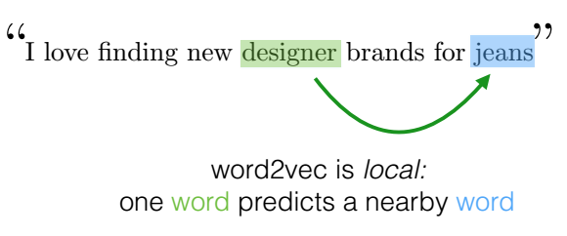
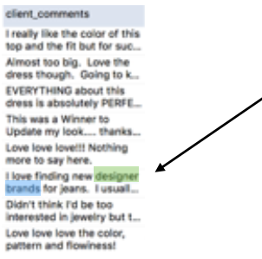
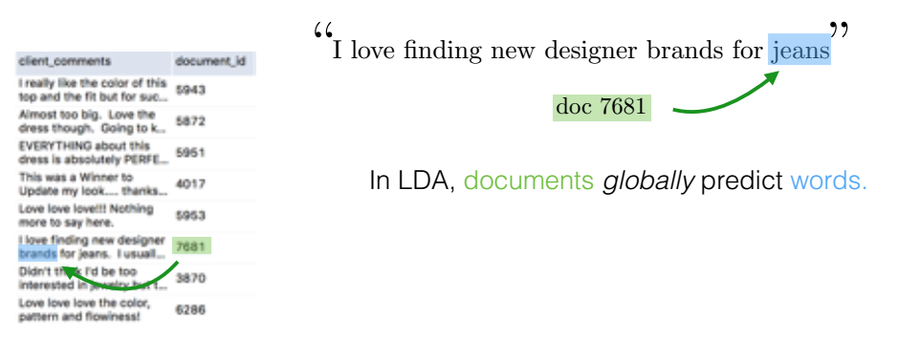
Difference
Notes:
Word2vec tries to model word-to-word relationships.
LDA models document-to-word relationships.
co-occurrence of the word and context
co-occurrence of the document and word
Word2vec reflect the information about semantic syntactic
LDA reflects the information about topic

Slide 19
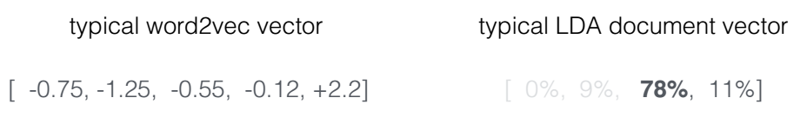
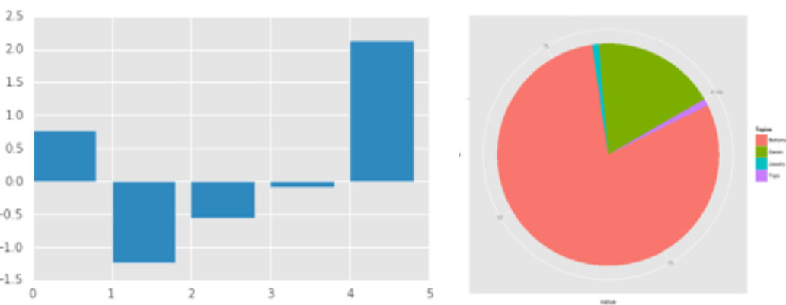
Difference
Notes:
Mathematical representation

Slide 20
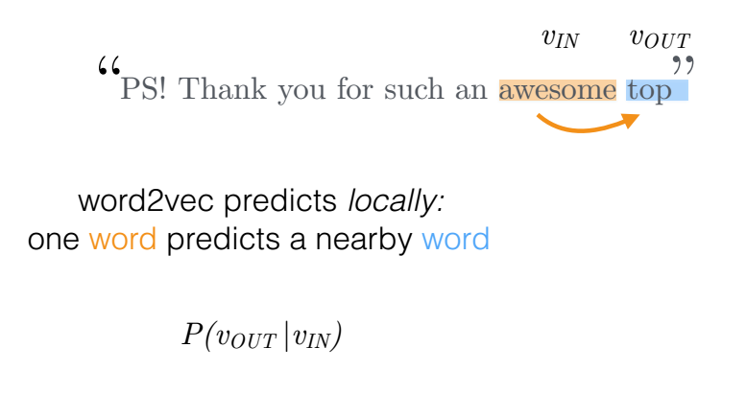
LDA2Vec

Slide 21
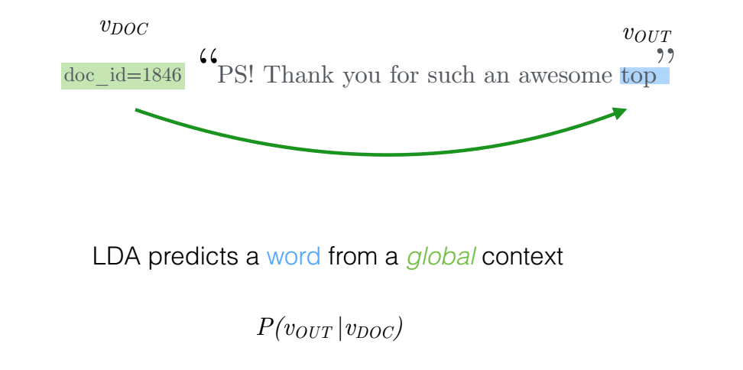
LDA2Vec

Slide 22
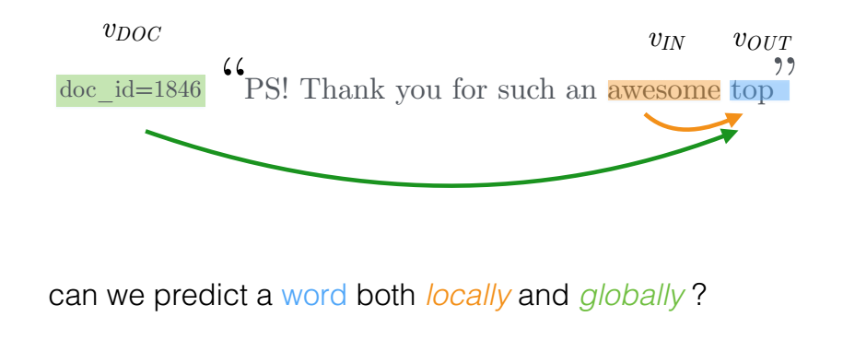


LDA2Vec

Slide 23
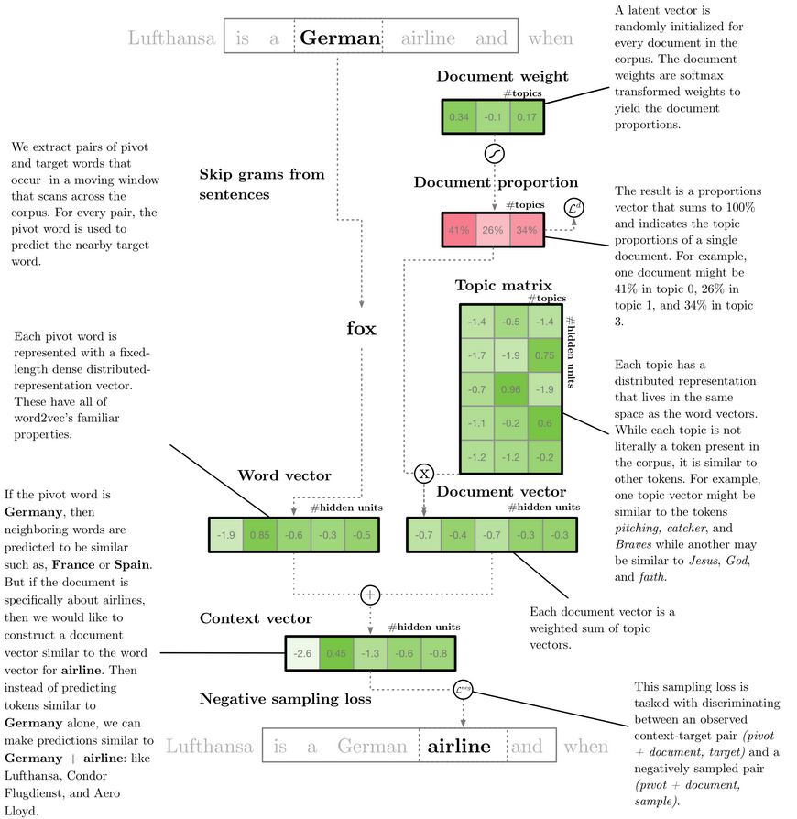
LDA2Vec
The goal: Use all of this context to learn interpretable topics.
German
Notes:
In a conclusion ,The lda2vec model tries to mix the best parts of word2vec and LDA into a single framework. word2vec captures powerful relationships between words, but the resulting vectors are largely interpretable and don't represent documents. LDA on the other hand is quite interpretable by humans, but doesn't model local word relationships like word2vec. This model that builds both word and document topics. It makes them interpretable.

Slide 24
Thank You

